Slide 1
An Analysis of the Breast Cancer Coimbra Dataset
CSC 642 - Final Project
Michelle Manfrini
Michela Effendie

Slide 2
Introduction
Breast cancer arises from the cells of the breast as a malignant tumor, also known as a collection of cancer cells.
Primarily affecting women, breast cancer can cause complications that target almost every area of the body. It is one of the leading causes of death among women.
In 2018, there were 9.6 million cancer-related deaths, 2.09 million being breast cancer.
This value will continue to rise unless prevented. Studies reveal that by avoiding or altering key risk factors, 30% to 50% of cancer deaths can be prevented.
Machine learning can assist medical professionals in identifying cases and improving treatments to reduce cancer cells
Notes:
Michela

Slide 3
Our Goal
We used the Breast Cancer Coimbra data for analysis, which includes multiple attributes related to breast cancer risk such as MCP-1 and HOMA
The dataset allowed us to train a model using these variables to predict future breast cancer diagnoses based on the quantitative attributes.
Our goal → develop a model that could accurately predict an individual’s diagnosis based on the quantitative attributes.
Notes:
Michelle

Slide 4
Research Questions
We were faced with a classification problem of the main target was to classify the individuals into healthy controls and affected patients.
Can the model accurately predict whether an individual has breast cancer based on the provided predictors?
Which attributes are significant in distinguishing between healthy and affected individuals?
How well does the model perform in terms of accuracy and reliability?
How clinically relevant and applicable is the model? Can it be used by healthcare professionals for early-stage breast cancer detection?
Notes:
Michela

Slide 5
State of the Art
Patricio et al …
built predictive models with logistic regression, support vector machines, and random forests. The Gini coefficient estimated how important variables were as predictors for breast cancer. Starting with the more significant, these were: Glucose, Resistin, Age, BMI, HOMA, Leptin, Insulin, Adiponectin, MCP-1.
Ghani et al …
combined many models such as decision trees, K-nearest neighbor, naive bayes, and artificial neural networks. The investigators implemented the hold-out validation method to find that the artificial neural network had the strongest performance with an accuracy of 80%.
Notes:
Michelle

Slide 6
Dataset
Two datasets:
The original “Breast Cancer Coimbra” dataset found in the UC Irvine Machine Learning Repository, with 116 instances based on clinical observations from 64 patients with breast cancer and 52 healthy controls.
The derived dataset from Kaggle which is a synthetic dataset from a deep learning model that was trained on the original. The synthetic dataset has 4,000 instances.
Notes:
Michelle

Slide 7
Dataset
Ten numerical variables and a binary categorical variable:
Age (years)
BMI (kg/m²)
Glucose (mg/dL)
Insulin (µU/mL)
HOMA: Homeostatic Model Assessment
Leptin (ng/mL)
Adiponectin (µg/mL)
Resistin (ng/mL)
MCP-1 (pg/dL)
The binary categorical variable is labeled with 1 for healthy controls and 2 for patients with breast cancer. These particular datasets do not contain missing values and are in comma-separated values (csv) files.
For the purpose of this project, both datasets, the synthetic and original, were used. The model was trained on the synthetic dataset and validated on the original dataset. Through this method, it was possible to determine the accuracy of the model’s prediction on actual data from clinical observations.
Notes:
Michela

Slide 8
Methods - Exploratory Data Analysis
Data type modification
Histogram plotting
Correlation matrices
Principal Component Analysis (PCA)
Notes:
Michela

Slide 9
Methods
Train/Val Split: training and validation sets comprise 70% and 30% of the synthetic data respectively, while the test set contains 100 percent of the original data.
Data is fit into different classical machine learning models:
K-Nearest Neighbors Classifier (KNN)
Linear Discriminant Analysis (LDA)
Quadratic Discriminant Analysis (QDA)
Logistic Regression
Hyperparameters tuning and resampling using 5-fold cross-validation
Evaluation: hold-out approach, confusion matrix, cross-validation, precision, recall, accuracy
Notes:
Michelle

Slide 10
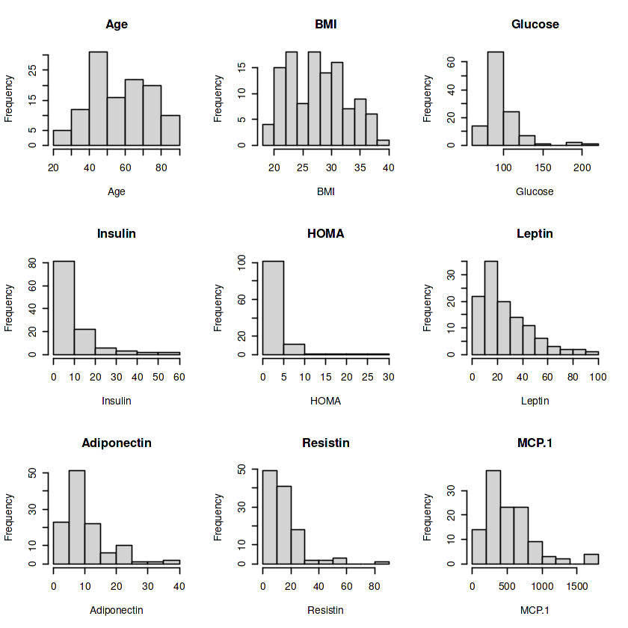
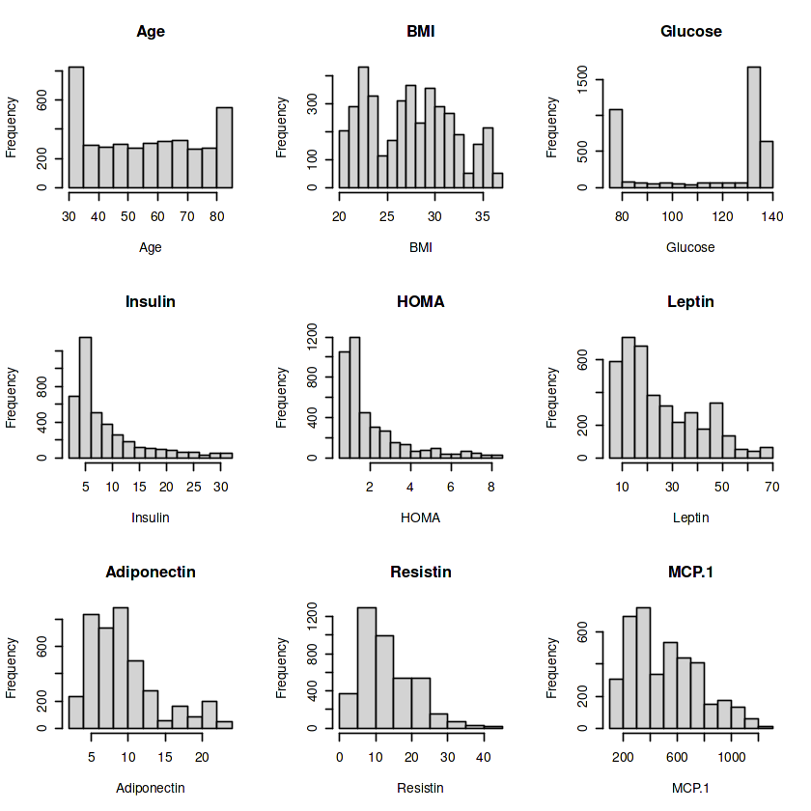
Results - EDA
Original dataset
Synthetic dataset
Notes:
Michelle
The histograms of the numeric variables in both datasets exhibited distributions that deviate from the normal distribution. The insulin, HOMA, leptin, adiponectin, resistin, and MCP.1 histograms from both datasets display a right-skewed distribution. The BMI histogram for both datasets mimic the plateau distribution. The age and glucose histograms show different shapes for each dataset. The synthetic dataset’s age and glucose histogram resemble the dog-food distribution while the original dataset resembles an edge-peak and right-skewed distributions respectively. Since none of the variables presents a normal distribution, the predictions made from the model trained and tested based on these datasets may be affected.

Slide 11
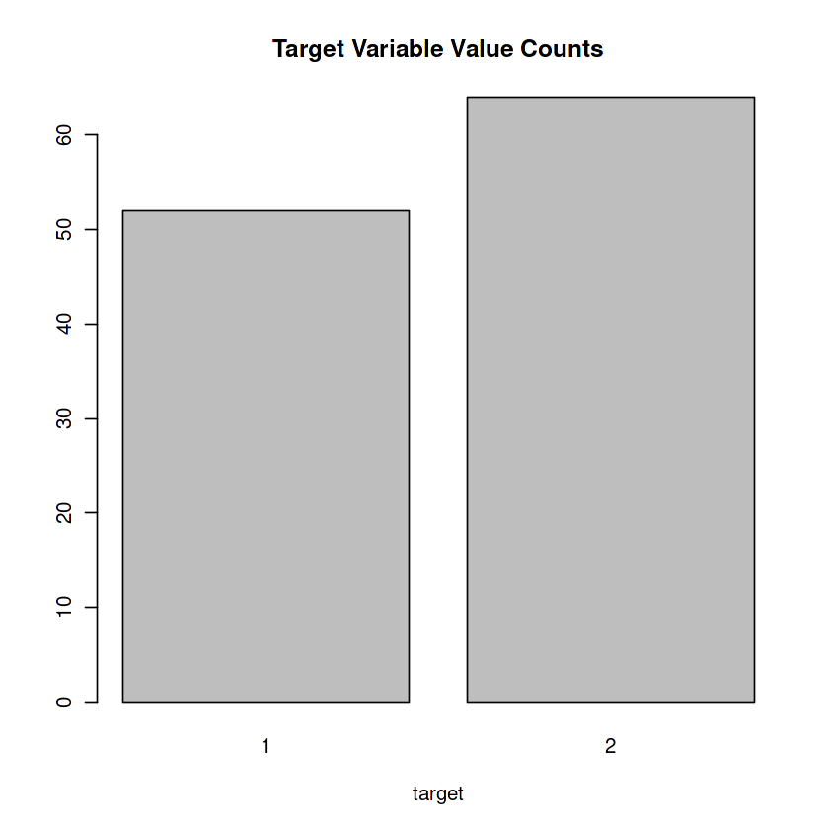

Results - EDA
Original dataset binary variable distribution
Synthetic dataset binary variable distribution
Notes:
Michela
The distribution of the binary categorical variable of both datasets seem to be fair.

Slide 12
Results - EDA
Synthetic dataset: 1784 healthy controls and 2216 patients with breast cancer
Original dataset: 52 healthy controls and 64 patients with breast cancer
imbalance does not appear to be problematic
mean and medians of the variables in both datasets appear to be similar
min, max, first quartile, and third quartile values differ
synthetic dataset variables seem to have a smaller range of values
Notes:
Michela

Slide 13
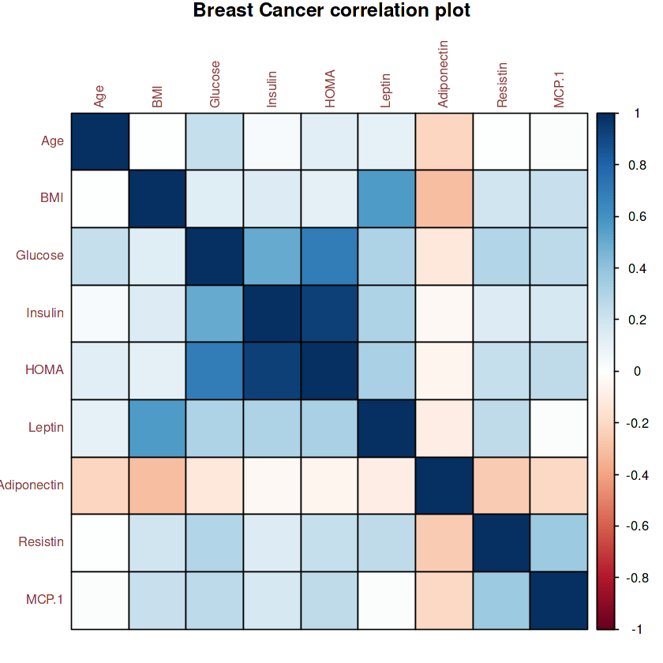
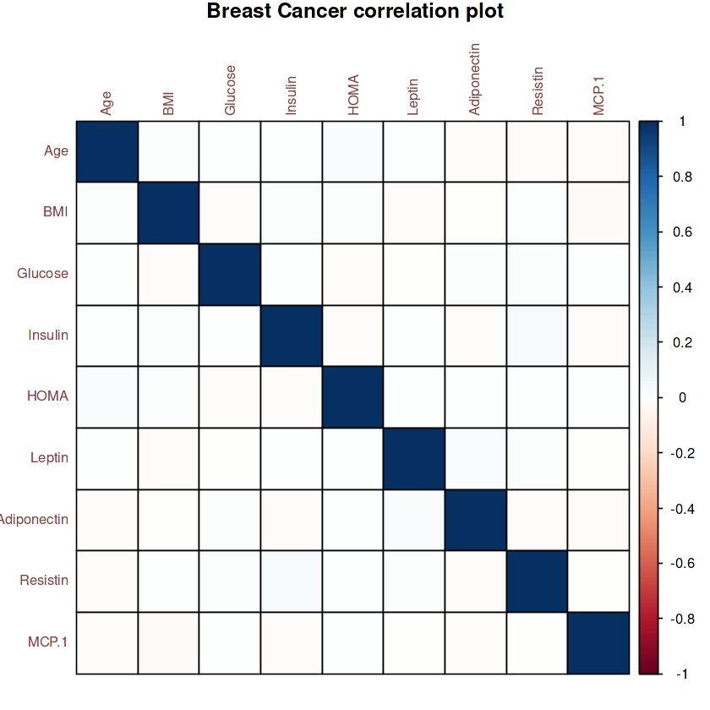
Results - EDA
Original dataset
Synthetic dataset
Notes:
Michelle
The variables in the synthetic dataset seem to have low correlation since its correlation coefficients are close to zero. The opposite is true for the original dataset. Its variables exhibit medium to strong correlations. This result is surprising, considering the synthetic dataset is generated from a deep learning model trained on the original dataset.

Slide 14
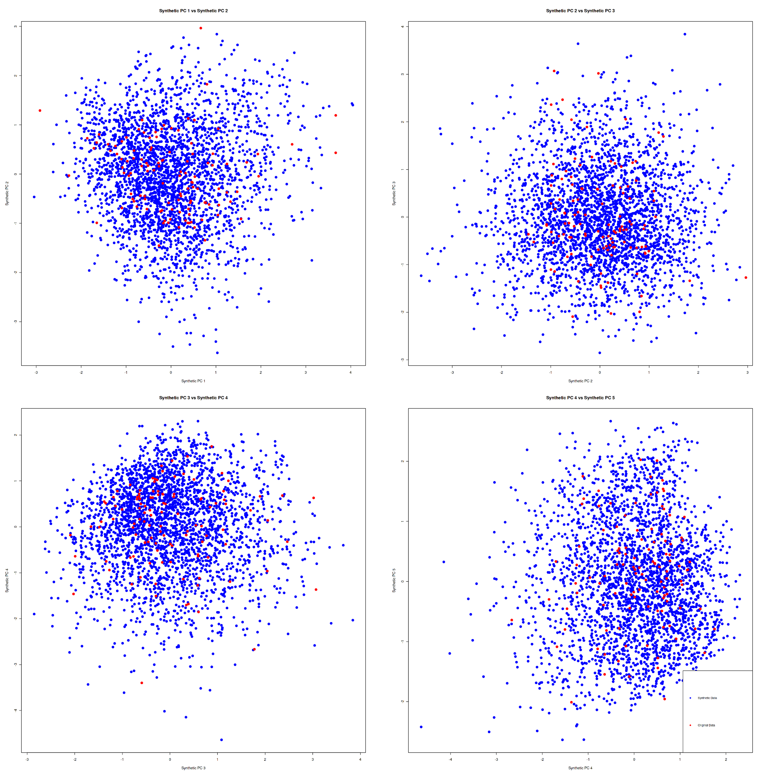
PCA
Notes:
Michelle
Due to the analysis derived from the correlation matrix, further investigation needs to be done. For simplicity, the distribution of PCs are plotted, since visual inspection is more practical to notice patterns or clusters. Homogeneous data would display points from both datasets distributed similarly without forming distinct clusters in a scatterplot. Based on this definition, the scatterplots generated in this method seem to suggest that the datasets are homogeneous, since there are no clusters and points from both datasets are spread out.

Slide 15
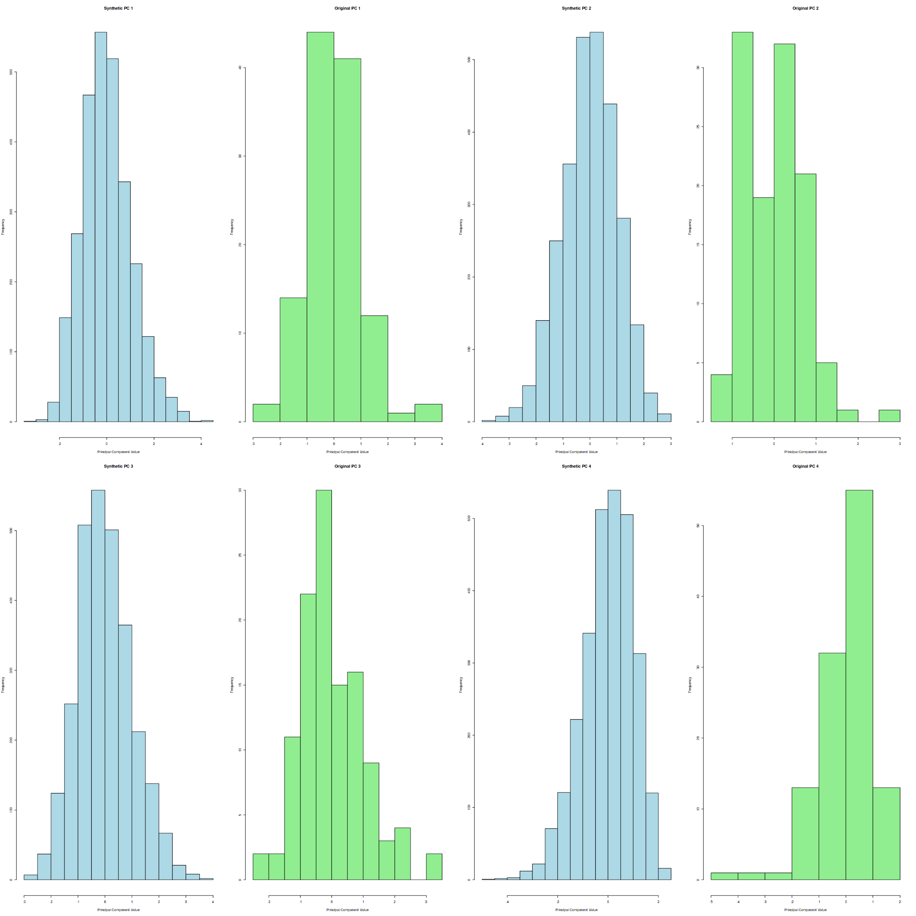
PCA
Notes:
Michela
The shapes of both the synthetic and original dataset are very similar. They exhibit similar distribution shapes with centers that are close or aligned. In addition, the spread of the histograms mimic each other, further indicating homogeneity. Based on the results, the variance explained and proportion of variance explained do not have noticeably large values.

Slide 16
Summary of Model Metrics on Validation and Test Set Before Hyperparameter Tuning
 | Test Error | Validation Error | Accuracy | Precision | Recall | F1 Score
Logistic Regression | 0.552 | 0.565 | 0.435 | 0.891 | 0.523 | 0.659
KNN | 0.457 | 0.454 | 0.546 | 0.953 | 0.550 | 0.701
LDA | 0.509 | 0.437 | 0.563 | 0.891 | 0.523 | 0.659
QDA | 0.526 | 0.459 | 0.541 | 0.750 | 0.516 | 0.611
Notes:
Michela

Slide 17
Cross-Validation Summary of Model Metrics on Test Set After Hyperparameter Tuning
 | Accuracy | Test Error | Precision | Recall | F1 Score
Logistic Regression | 0.448 | 0.552 | 0.984 | 0.548 | 0.704
KNN | 0.517 | 0.482 | 0.640 | 0.554 | 0.594
LDA | 0.491 | 0.508 | 0.891 | 0.523 | 0.659
QDA | 0.474 | 0.526 | 0.750 | 0.516 | 0.611
Notes:
Michelle
Logistic Regression - has the highest precision and F1. Relatively good recall, won’t miss a significant number of actual positive cases.
KNN - lowest precision but higher recall than LR.

Slide 18
Confusion Matrix of Models After Hyperparameter Tuning: Test Set
Logistic Regression | KNN | LDA | QDA
test.y glm.pred_test 1 2 1 0 7 2 52 57 | test.y knn.pred_test 1 2 1 19 23 2 33 41 | test.y lda.class 1 2 1 0 7 2 52 57 | test.y qda.class 1 2 1 7 16 2 45 48
Notes:
Michelle
LDA has a high tendency to predict that patients have breast cancer, and this situation is also evident in the logistic regression model. The KNN and QDA models seem to be predicting more evenly, with a lower tendency to predict a certain class. Based on these observations, there does not seem to be a model that performs significantly better than the other models. There are trade-offs when selecting the “best” model, but the QDA seems to be the highest performing model since it does not have a high tendency to predict one class over the other and its metrics are only second to LDA.

Slide 19
Results
Pre-Tuning Model Metrics:
LDA model shows highest accuracy score.
Metrics seem comparable to other models, but confusion matrix reveals bias.
High tendency of LDA to predict one class, affecting generalizability.
Confusion Matrix Insights:
LDA and logistic regression show bias towards predicting positive cases.
KNN and QDA exhibit more balanced predictions across classes.
Post-Tuning Model Analysis:
LDA maintains strong performance after tuning.
KNN outperforms LDA in accuracy, recall, and test error.
Logistic regression, despite lower accuracy, achieves highest precision and F1 score.
Notes:
Michela

Slide 20
Conclusions
No single model significantly outperforms others.
Trade-offs present in model selection.
KNN emerges as top performed considering all evaluation metrics, including confusion matrix.
Notes:
Michela

Slide 21
Future Work
Future studies should assess additional prediction models, feature selection methods, and more expansive clinical datasets.
The models should also be trained, validated, and tested using the single original Breast Cancer Coimbra dataset. We did not have success with the synthetic data derived from Kaggle.
More research must be conducted to verify the relationship between these quantitative attributes and a true diagnosis of breast cancer.
Notes:
Michela

Slide 22
Bibliography
"Breast Cancer Coimbra." UCI Machine Learning Repository, archive.ics.uci.edu/dataset/451/breast+cancer+coimbra. Accessed 25 Jan. 2024.
Agrawal, Vivek. "Breast Cancer Coimbra." Kaggle, 7 Jan. 2024, www.kaggle.com/datasets/atom1991/breast-cancer-coimbra.
Alfian, G.; Syafrudin, M.; Fahrurrozi, I.; Fitriyani, N.L.; Atmaji, F.T.D.; Widodo, T.; Bahiyah, N.; Benes, F.; Rhee, J. Predicting Breast Cancer from Risk Factors Using SVM and Extra-Trees-Based Feature Selection Method. Computers 2022, 11, 136. https://doi.org/10.3390/computers11090136
Ghani, M.U.; Alam, T.M.; Jaskani, F.H. Comparison of Classification Models for Early Prediction of Breast Cancer. In Proceedings of the 2019 International Conference on Innovative Computing (ICIC), Lahore, Pakistan, 9–10 November 2019; pp. 1–6.
Jin Yue, Na Zhao, and Liu Liu. "Prediction and Monitoring Method for Breast Cancer: A Case Study for Data from the University Hospital Centre of Coimbra." Cancer Management and Research, vol. 12, 2020, pp. 1887-1893, DOI: 10.2147/CMAR.S242027.
Khatun, T.; Utsho, M.M.R.; Islam, M.A.; Zohura, M.F.; Hossen, M.S.; Rimi, R.A.; Anni, S.J. Performance Analysis of Breast Cancer: A Machine Learning Approach. In Proceedings of the 2021 Third International Conference on Inventive Research in Computing Applications (ICIRCA), Coimbatore, India, 2–4 September 2021; pp. 1426–1434.
Nanglia, S.; Ahmad, M.; Khan, F.A.; Jhanjhi, N. An enhanced Predictive heterogeneous ensemble model for breast cancer prediction. Biomed. Signal Process. Control 2021, 72, 103279.
Patrício, M., Pereira, J., Crisóstomo, J. et al. Using Resistin, glucose, age and BMI to predict the presence of breast cancer. BMC Cancer 18, 29 (2018). https://doi.org/10.1186/s12885-017-3877-1
Rustam, Zuherman, and Ajeng Leudityara Fijri. "IOPscience." Journal of Physics: Conference Series, vol. 1490, no. 1, IOP Publishing, 2020, p. 012028, iopscience.iop.org/article/10.1088/1742-6596/1490/1/012028.
World Health Organization. "Cancer." World Health Organization, www.who.int/health-topics/cancer#tab=tab_1. Accessed 24 Jan. 2024.

